Slide 1

CHURN PREDICTION
PROJECT

Slide 2
Some basic Information about the Dataset
I have done an EDA and build a ML model on the dataset of “Customers to predict the churn whether the customer will be retained or not”.
The dataset consist of 14 columns and 10,000 rows.

Slide 3
Objectives
Perform Basic EDA
Data Cleaning
Building a classification model first and calculate Confusion Matrix, AUC, F1 Score, Precision, Recall and Accuracy.
Build at least a minimum of 4 different Regression models. All the models should use K-Fold cross Validation to train the model with at least 5-fold cross validation.
Run hyper-parameter tuning on all the models and pick the best parameters (A minimum of 2 Parameters should be tuned) and picked.
Now, compare the models and pick the ideal one.

Slide 4
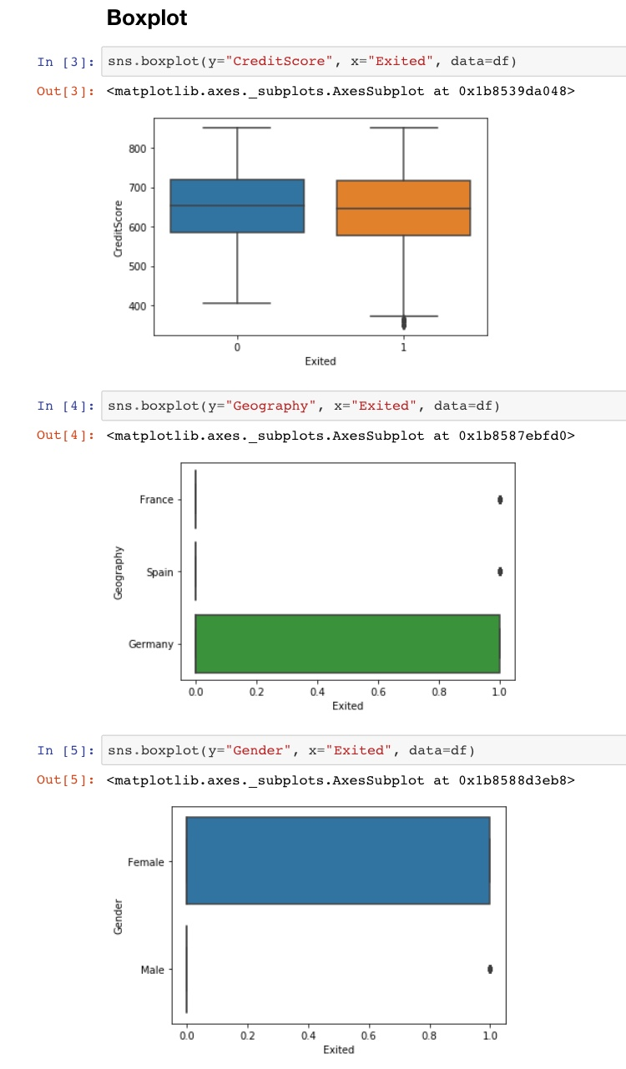
Boxplot
The boxplot are plotted between target variable ‘Exited’ and other non-targeted variables like ‘Credit Score’, ‘Geography’, ‘Gender’, ‘Number Of Products’, ‘Age’, ‘Tenure’, ‘Balance’ and ‘Estimated Salary’.
When the boxplot is plotted between age and exited. It show that the people of age between 45 to 60 are more likely to exit the company.
When the boxplot is plotted between balance and exited. It shows that the people with low Balance has very low chances to leave the company.

Slide 5
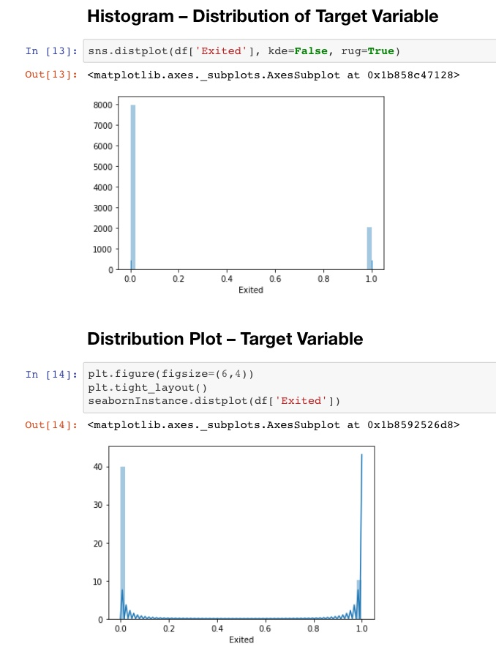
Histogram & Distribution Plot
The Histogram and Distribution Plot are clearly showing that about 20% of the total Customers are willing to exit the company.
And about 80% of the customers are willing to stay with the company which is a positive thing.

Slide 6
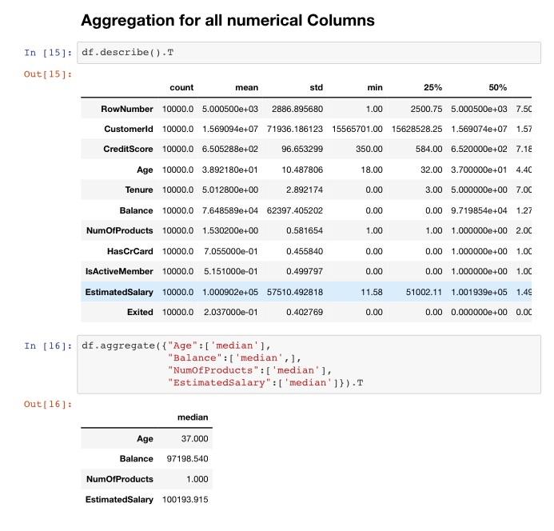
Aggregation for all numerical columns
From aggregation we can tell that what is the range of the age, balance and estimated salary of the customers.
Like for age we can say that the youngest customer is of 18 yo. And the eldest customer is of 92 yo.
And fro Estimated salary we can say that the least salary of a customer is 12 and highest is 199990.

Slide 7
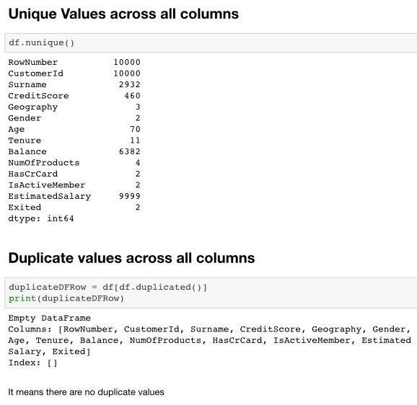
Unique & Duplicate values across all columns
There are total 10000 rows and 14 columns.
And there are no duplicate rows in the dataset.

Slide 8
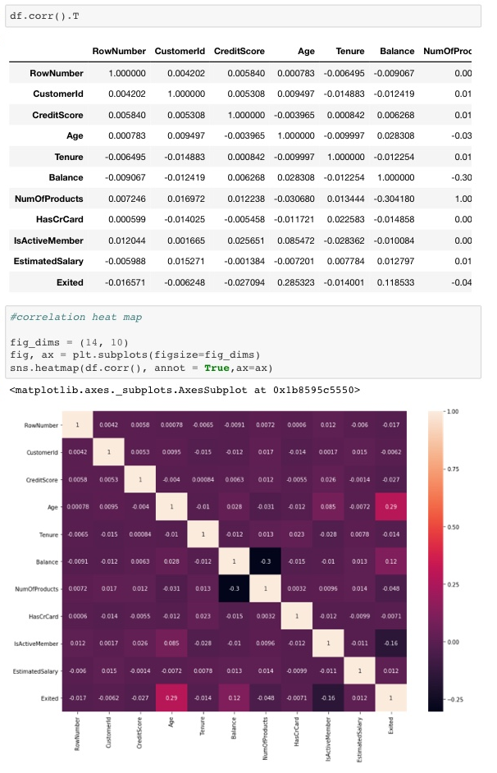
Correlation Heat map
Visualization is generally easier to understand than reading tabular data, heat maps are typically used to visualize correlation matrices.
Here age has correlation of 0.3 with target variable.

Slide 9
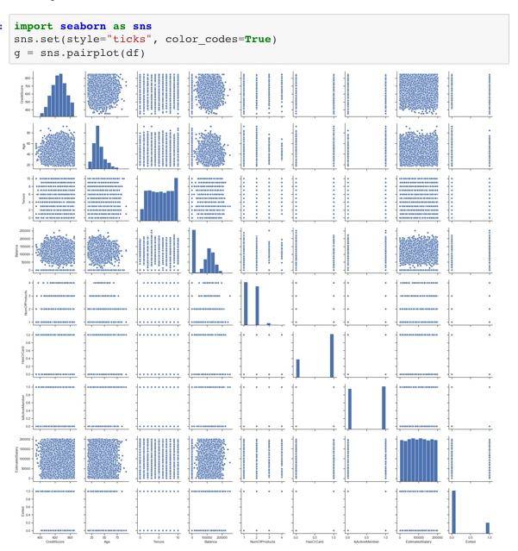
Pair Plot
A pairs plot allows us to see both distribution of single variables and relationships between two variables .
Pair plots are a great method to identify trends for follow-up analysis and, fortunately, are easily implemented in Python.

Slide 10
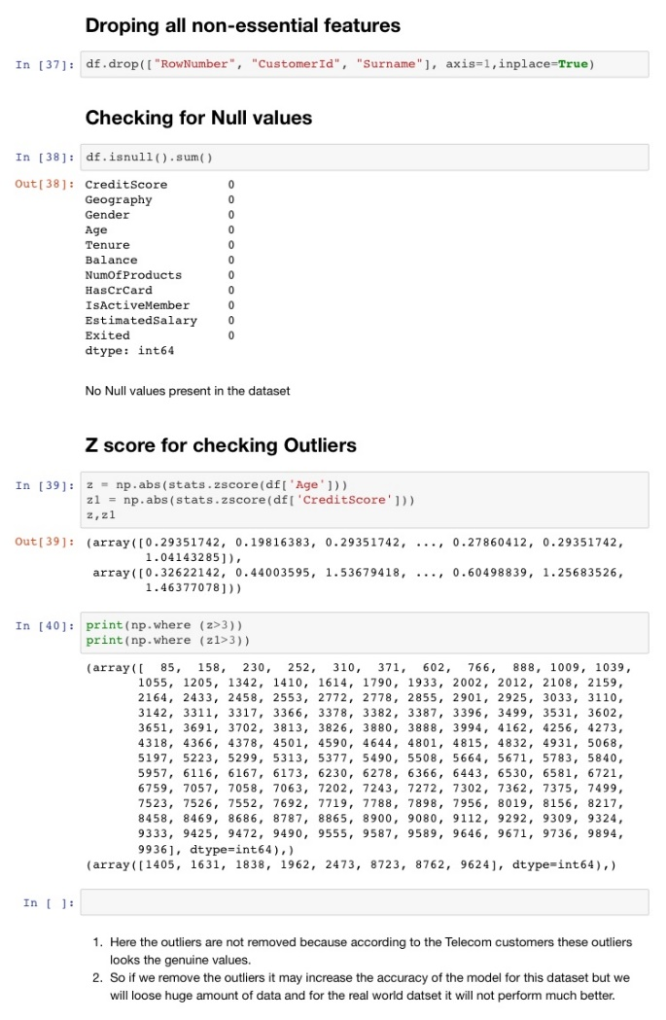
Data Cleaning for Modeling
Dropping the non essential columns. Which are ‘Row Number’, ‘Customer Id’ and ‘Surname’.
And no null values are present in the dataset.
Here the outliers are not removed because according to the Telecom customers these outliers looks the genuine values.
So if we remove the outliers it may increase the accuracy of the model for this dataset but we will loose huge amount of data and for the real world dataset it will not perform much better.

Slide 11
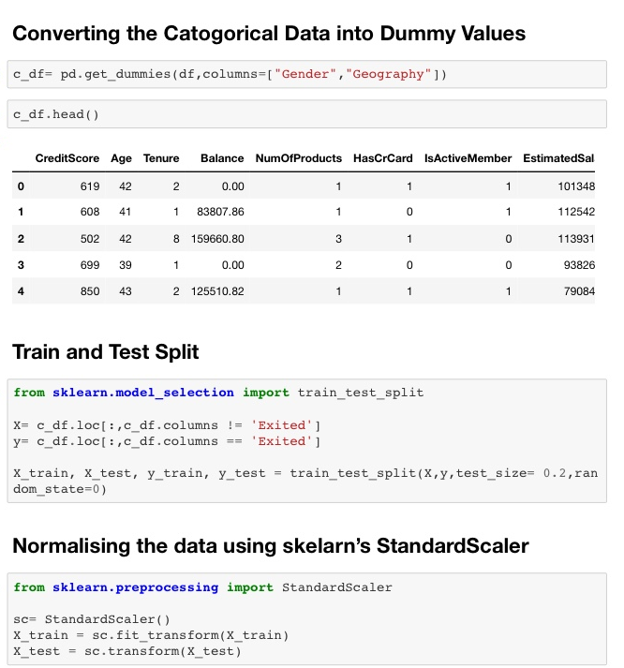
Data Preprocessing
Converting the categorical variables into numerical data using dummy variables.
Initializing the data into X and y for train and test.
Then normalized the data using sklearn preprocessing standard scalar.

Slide 12
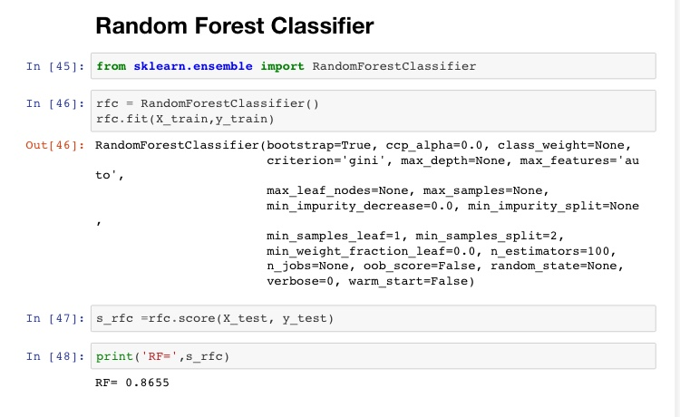
Random Forest Classifier
Using Random Forest Classifier to fit training data set.
The accuracy I got is 86.55.
I have also used other models like Logistic Regression, Support Vector machine and K-Nearest Neighbor to obtain the best model for this dataset.

Slide 13
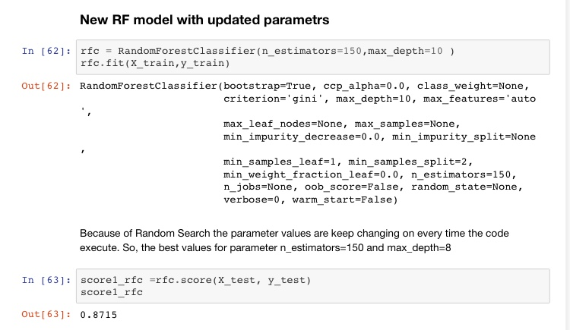
After hyper parameter optimization
To increase the performance of the existing model I have applied hyper parameter optimization .
I have used the Randomized searchCV to identify the best values for the parameters like n_estimators and max_depth.
Then the Random Forest Classifier’s efficiency improved by 0.6% .

Slide 14
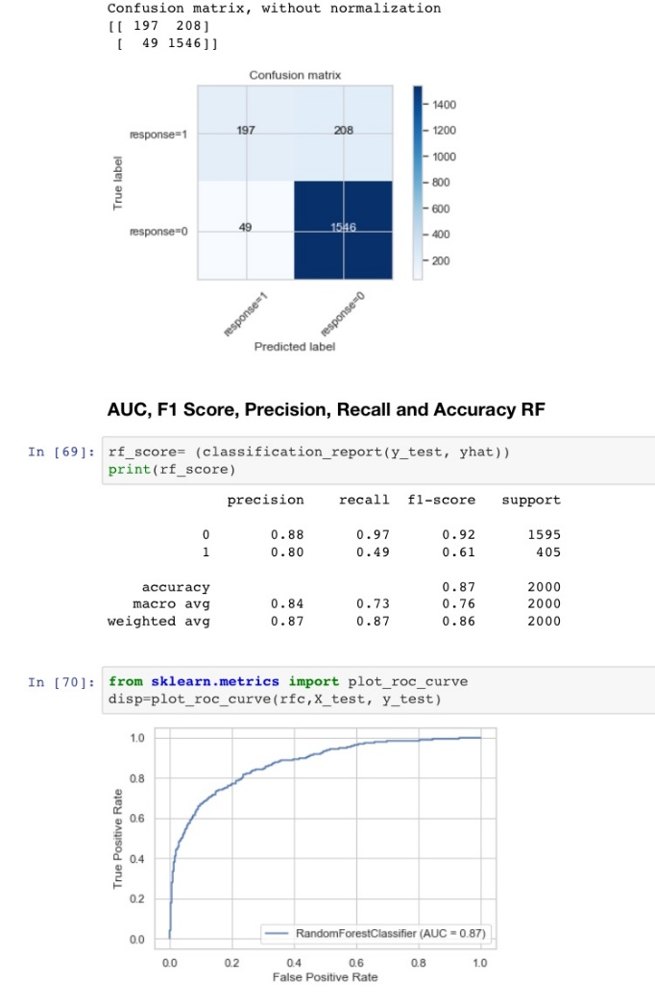
Confusion Matrix, AUC, F1 Score, Precision and Accuracy of RFC
Confusion Matrix : [ [ 256 253 ]
[ 65 1926 ] ]
AUC : 0.87
F1-Score : 0.86
Precision : 0.87
Recall : 0.87
Accuracy : 0.87

Slide 15
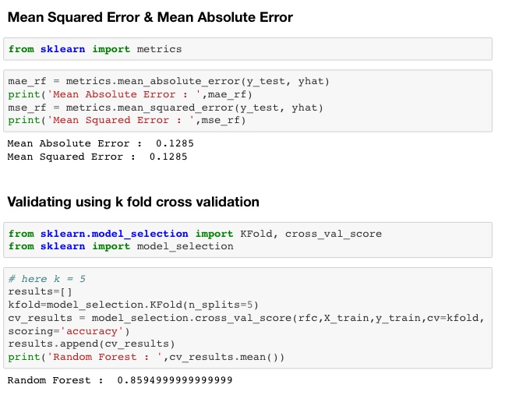
K fold cross validation & Errors
Here I have done 5 fold cross validation.
The score after 5 fold cross validation is 0.8594
The Mean Squared Error is 0.1285.
The Mean Absolute Error is 0.1285.

Slide 16
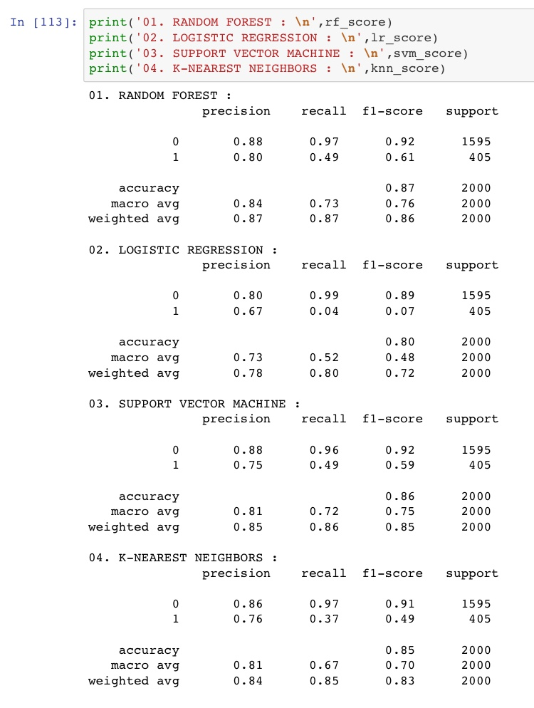
Final report for Random Forest, Logistic Regression, Support vector machine & K-Nearest Neighbors
Here is the detailed comparison of the different models.
RFC Accuracy : 0.87
Precision : 0.87
LR Accuracy : 0.80
Precision : 0.78
SVM Accuracy : 0.86
Precision : 0.85
KNN Accuracy : 0.85
Precision : 0.84

Slide 17
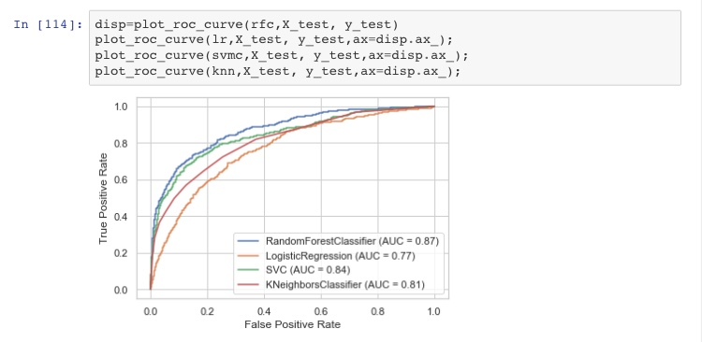
Comparing with ROC Curves & AUC
The AUC values for the models are as follows :
RFC : 0.87
LR : 0.77
SVM : 0.84
KNN : 0.81

Slide 18
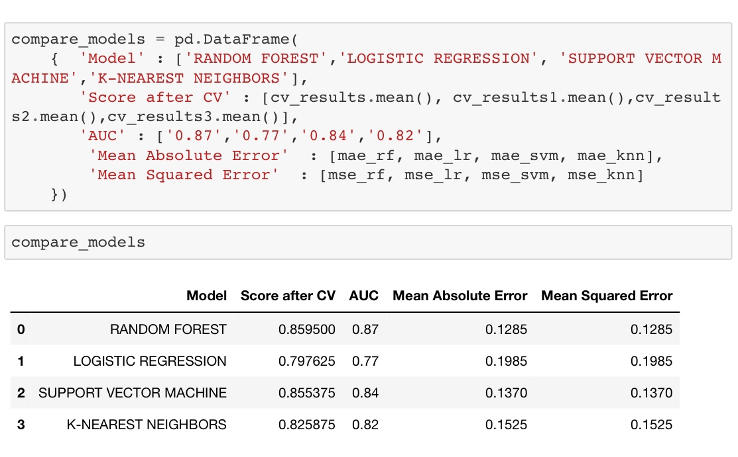
Conclusion
So the model with the highest Accuracy=87.15, Precision=87, AUC=87 and lowest MAE=12.85, MSE=12.85 is RANDOM FOREST CLASSIFIER

Slide 19
Learnings from this project
I get to know about a new ML model Support Vector Machine.
I learned about Hyper parameter optimization. Why it is important and how it can improve the performance of the model.
I get to know about two search methods used in hyper parameter optimization which are Randomized searchCV and Grid searchCV.

Slide 20
THANK YOU
Submitted by : Yogender Kushwaha
LinkedIn: https://www.linkedin.com/in/yogender-kushwaha/
Project Link: https://github.com/YogenderKushwaha/Churn-Prediction

